Slide 1


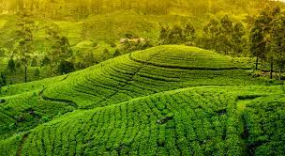

TeaBot
Tea Plantation Preservation Using an Intelligent Robot

Slide 2

Background
Most significant export product contributing to the GDP in Sri Lanka.
Well-known history and the Ceylon Tea is a well-known brand.
Mild weather and a rich soil to grow tea.
Plenty of human resources to maintain large scales of tea estates.
Tea plants need a continuous hydration and nutrition supply.
Needs a good maintenance and it highly costs.
People moved for different occupations with the industrial revolution.

Slide 3
Introducing TeaBot…
TeaBot is a well developed autonomous robot to replace the human resource
Watering and fertilizing for tea estates. (Liquid fertilization)
Operate in off road conditions
No need a highly arranged clear paths to navigate.
Increasing the efficiency and decrease the water and fertilizer wastage.
TeaBot can identify the path to navigate and identify the end of the plant stems and liquid fertilizing the plants efficiently.

Slide 4

Research Question
How to develop the TeaBot for the liquid fertilization process efficiently?

Slide 5
Objectives
Develop the robot controller of the TeaBot to navigate in off-road conditions with the computer vision guidance.
The development of the image segmentation model to navigate the robot automatically in the tea plantation rows in varying environmental conditions
Develop an image processing algorithm to precisely identify the end of the tea stem and pass the coordinators to the liquid spraying controller.
Develop the liquid nozzles controller of the TeaBot to liquid fertilize the tea plants more efficiently.

Slide 6
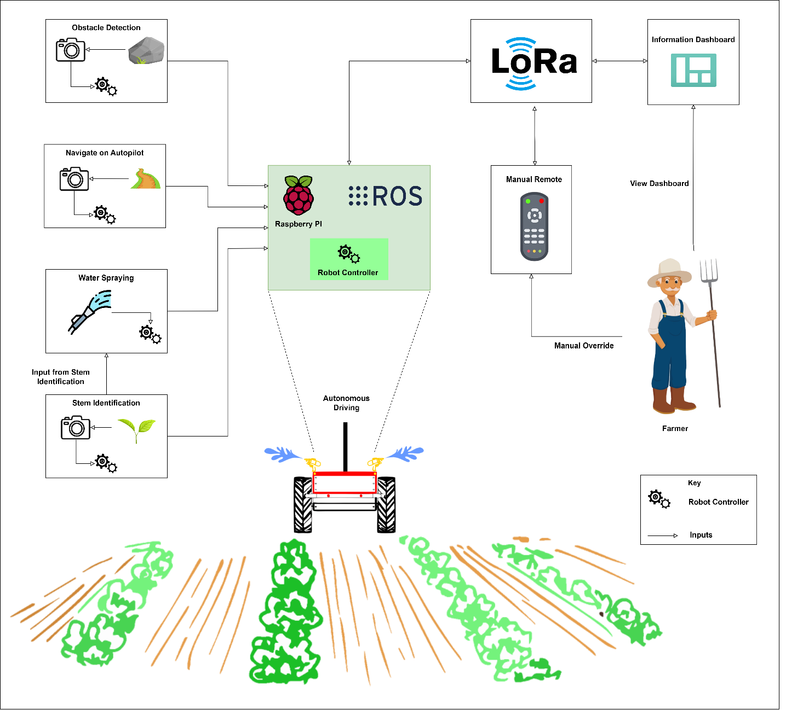
System Overview Diagram

Slide 7
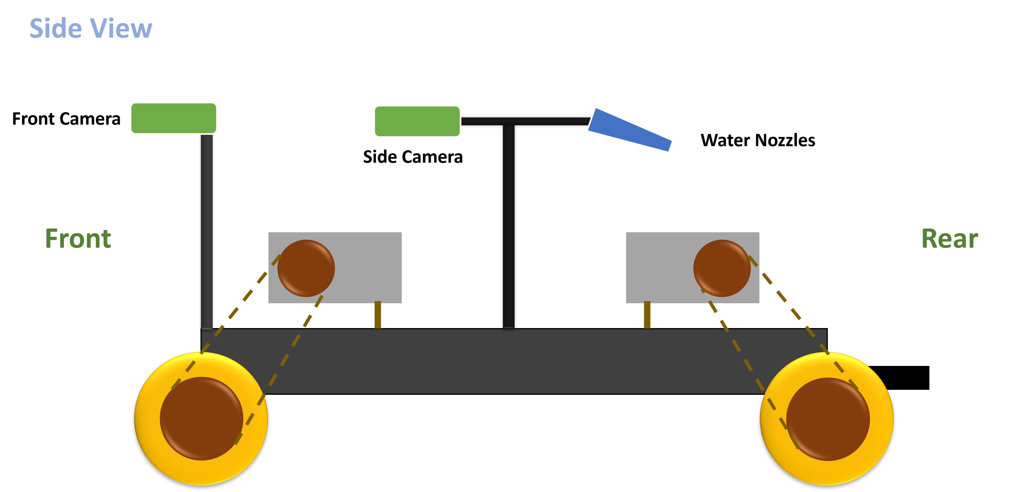

Slide 8
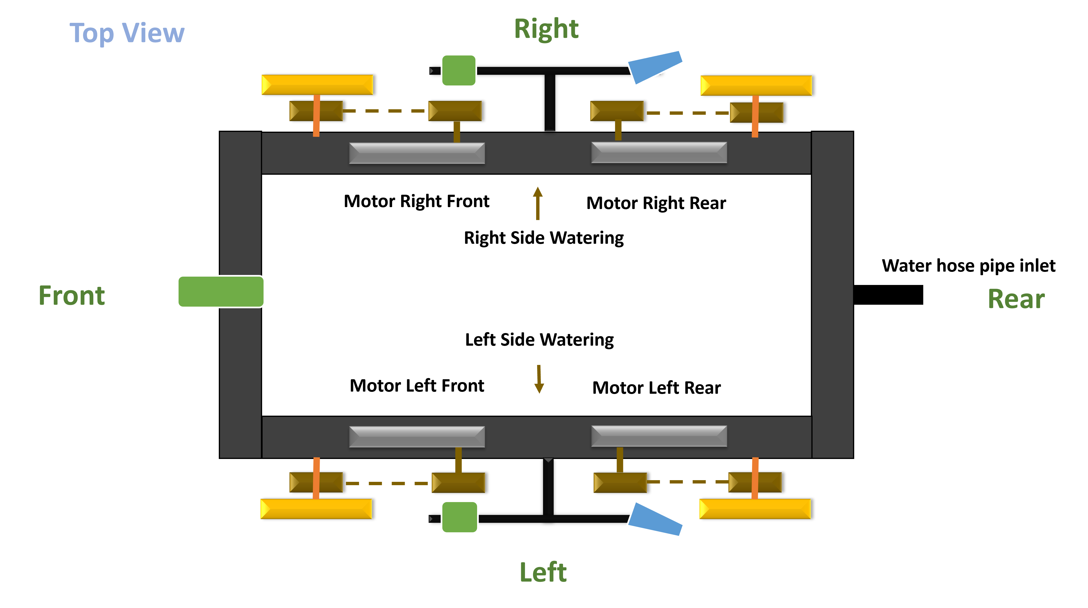

Slide 9
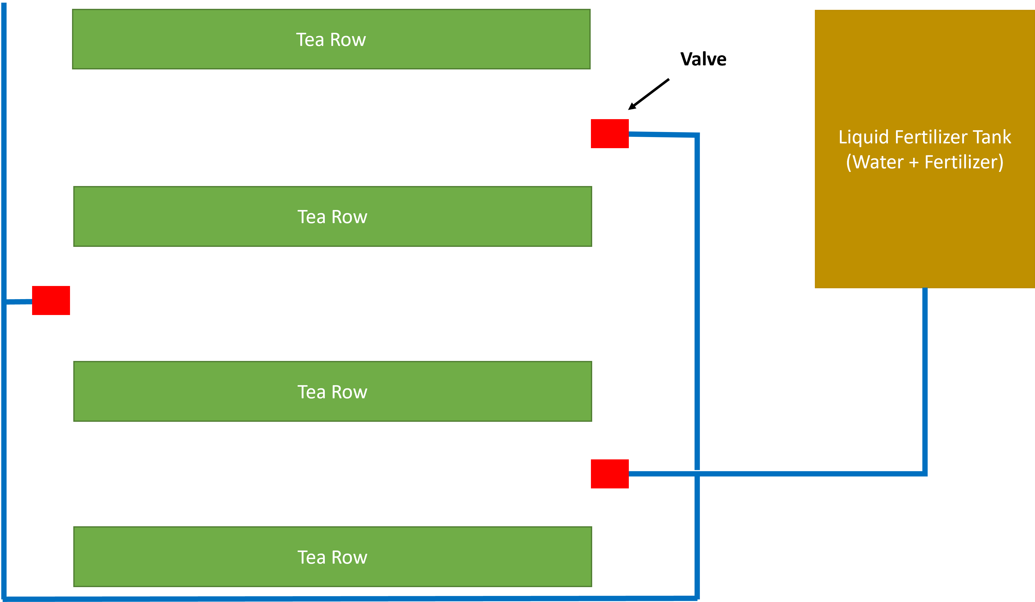
What is liquid fertilization?

Slide 10
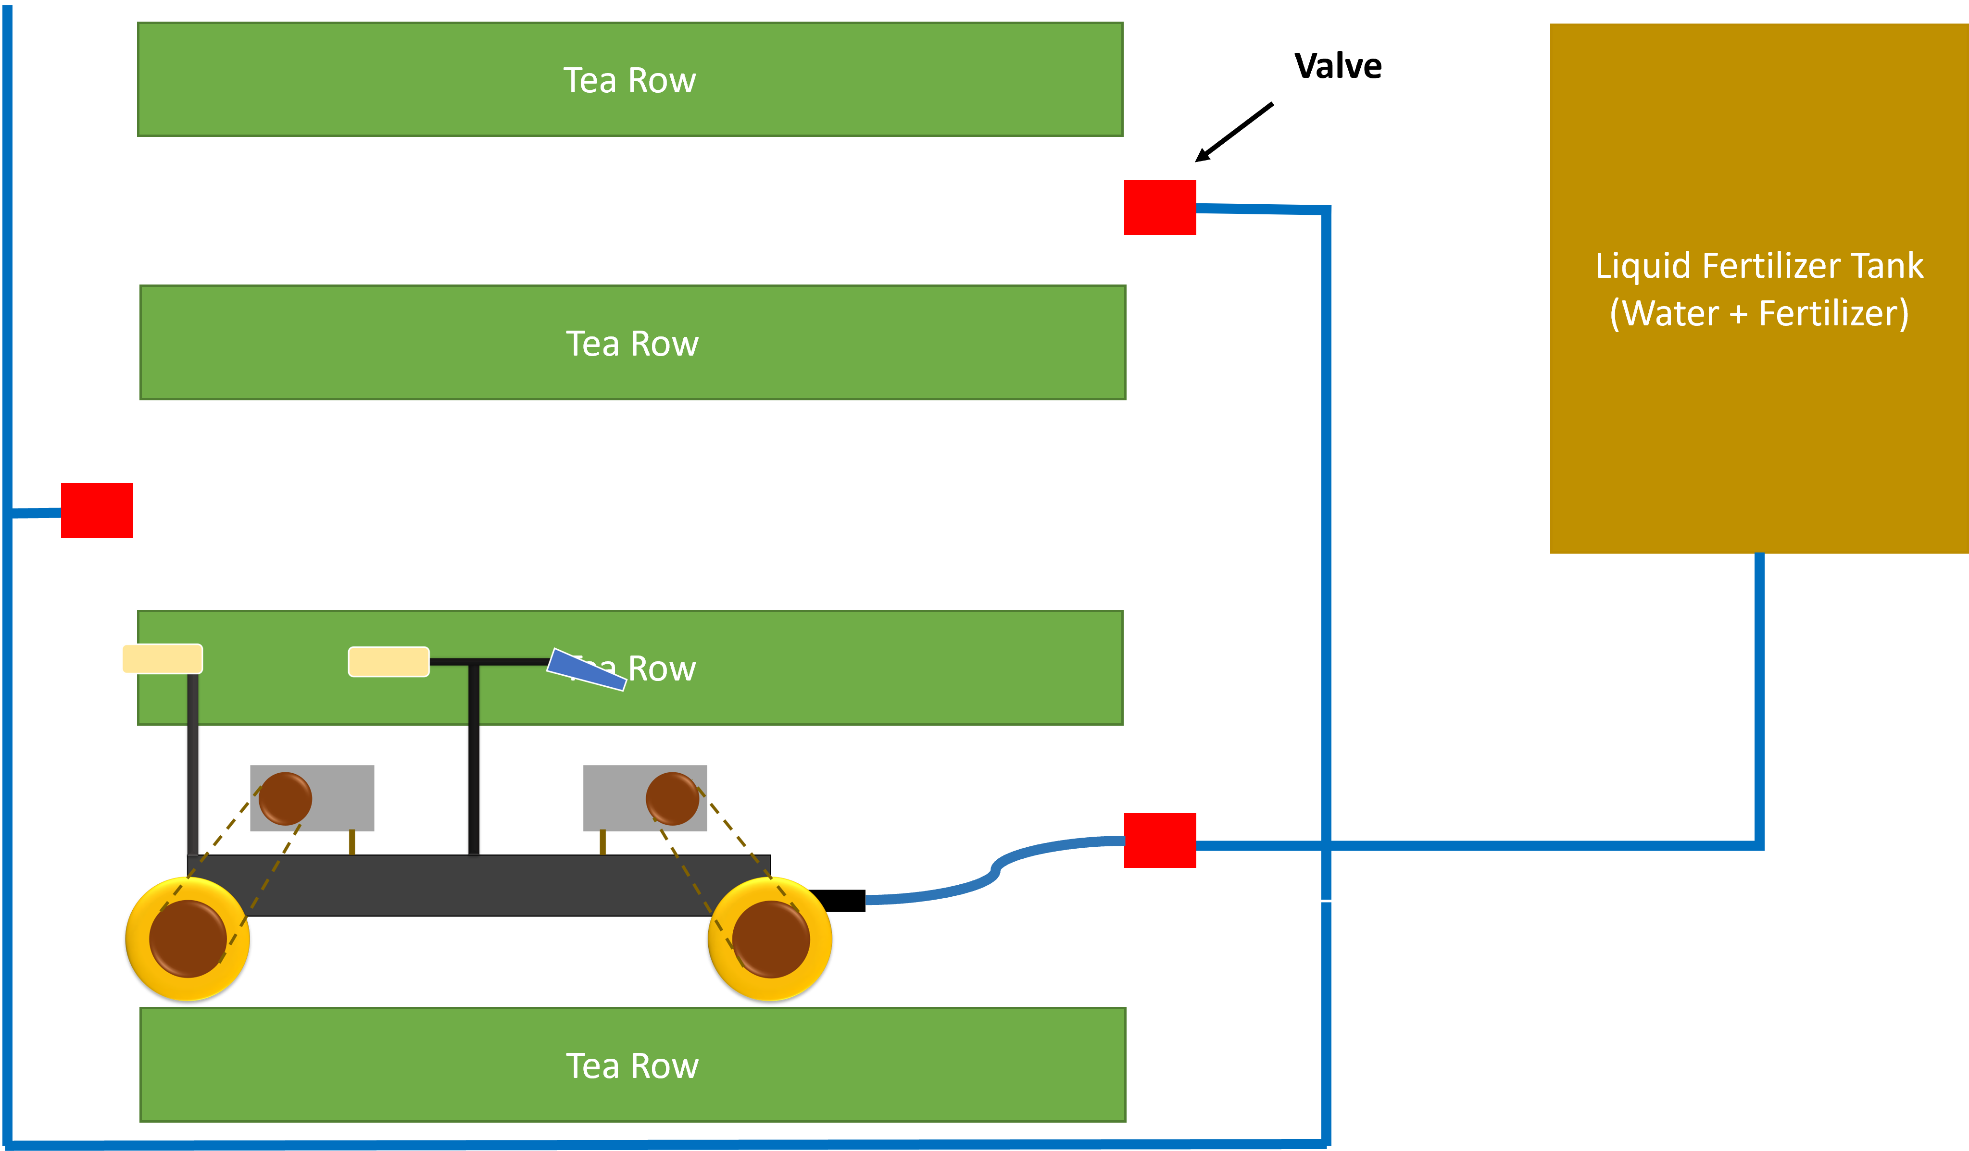

Slide 11

IT19973470 Gunawardana I.I.E Software Engineering
IT19973470 | Gunawardana I.I.E | TMP-23-044

Slide 12
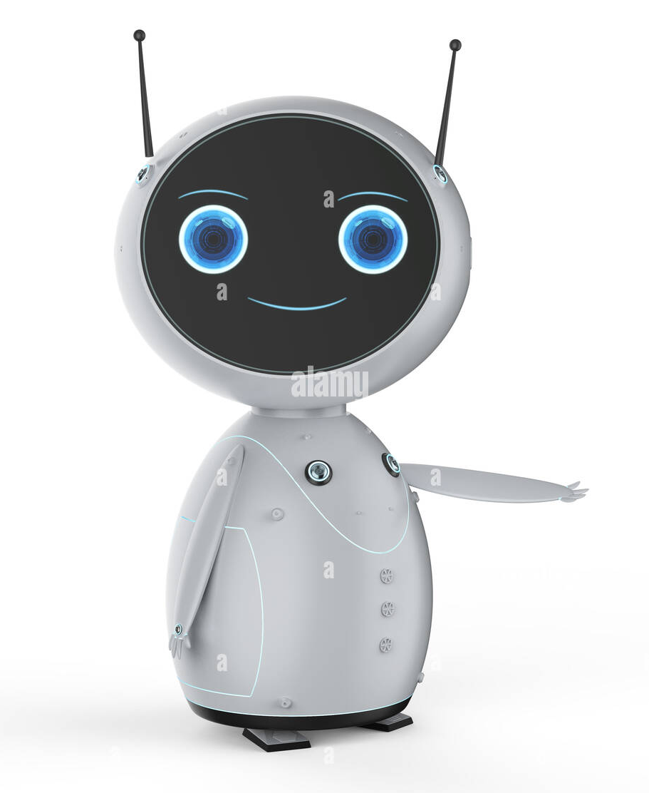
INTRODUCTION
IT19973470 | Gunawardana I.I.E | TMP-23-044

Slide 13
Background
Thorvald II Four-wheel steering strawberry harvesting agriculture robot [1].
RagriBot four-wheel drive robotic platform with skid steering and powered by solar [2].
AgriBot including four-wheel steering (4WS) and it is a large size robot. The center of gravity is in a bit upper position [3].
The BoniRob autonomous navigation agriculture robot over row-based cultures, using sensors, lidar, wifi and Intel Atom embedded pc for computing [4].
Agri robot Crop Phenotyping powered by an Intel NUC [5].
IT19973470 | Gunawardana I.I.E | TMP-23-044

Slide 14
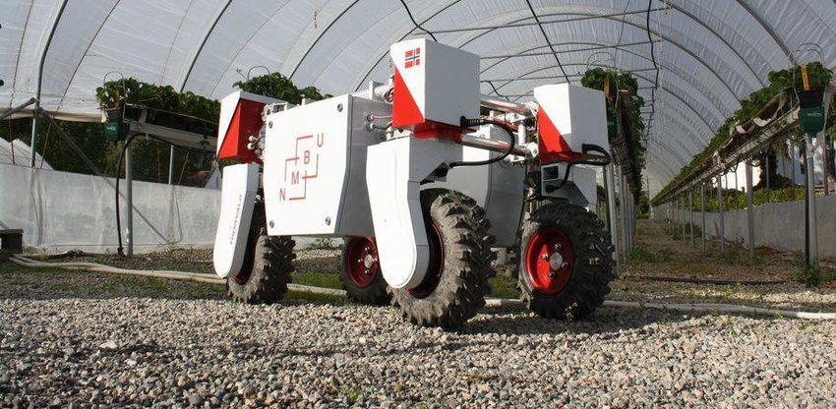
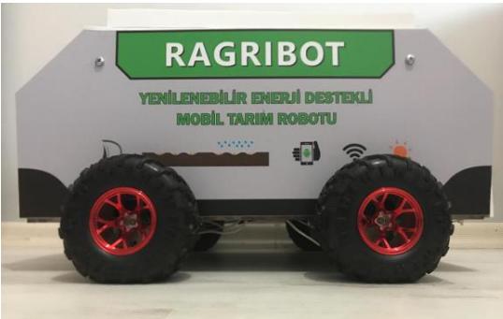
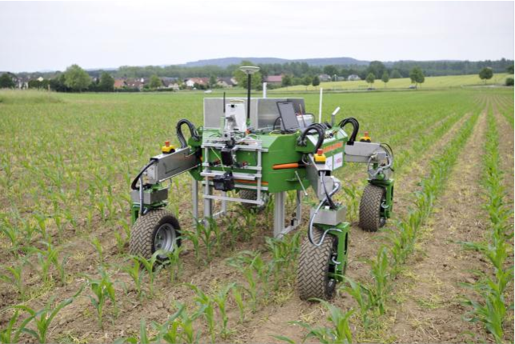
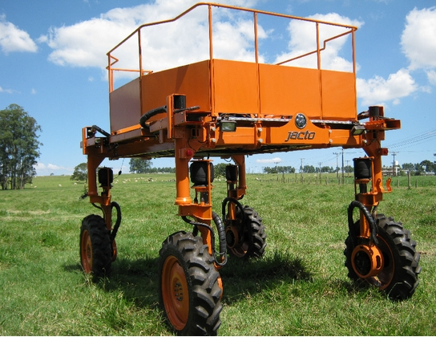
Implemented Solutions
Implemented Solutions
Thorvald
Ragribot
BoniRob
Agribot
IT19973470 | Gunawardana I.I.E | TMP-23-044

Slide 15
Research Gap
Miniature robots are suitable for greenhouse environment
Power management and the operation of the wheel are the most suitable for flat terrain.
2W drive is not suitable for rough terrain since it needs more power for off-road levels.
2WS is a bit challenging when needs to turn the robot in a limited space.
4WS, needs more motor power and a mechanism to rotate all wheels.
Center of gravity is higher in large robots, and not suitable for slope lands.
Solar power is not eligible when driving under trees.
Arduino is limited to doing motor control, sensor reading, and working with the cloud.
No auto stop function for any hazard.
IT19973470 | Gunawardana I.I.E | TMP-23-044

Slide 16
Comparison
Robot | Wheels Mechanism | Power Supply | Computer | Scale | Eligibility for tea fields
Thorvald | 4WD, 4WS | 12V Li battery (High power) | Dedicated robot control unit | Extra Large (200 kg) | ✘
Ragribot | 4WD, Skid steering | Solar Power | Raspberry Pi + Arduino | Small | ✘
Agribot | 4WD, 4WS | 12V (High power) | Dedicated robot control unit | Extra Large (150 kg) | ✘
BoniRob | 4WD, 4WS | 12V (High power) | Intel Atom | Extra Large | ✘
TeaBot | 4WD, Skid steering | 12V (Low power) | Raspberry Pi (Python / ROS) | Fair (2 x 2 feet) (30 kg) | ✓
IT19973470 | Gunawardana I.I.E | TMP-23-044

Slide 17
Research Question
How to navigate the TeaBot efficient in off-road conditions with the computer vision guidance and maintain the power more effective?
IT19973470 | Gunawardana I.I.E | TMP-23-044

Slide 18
OBJECTIVES
IT19973470 | Gunawardana I.I.E | TMP-23-044

Slide 19
Specific Objective
Develop the robot controller of the TeaBot to navigate in off-road conditions with the computer vision guidance.
IT19973470 | Gunawardana I.I.E | TMP-23-044

Slide 20
Sub Objectives
Design the robot chassis to easily drive, easily handle and consume a low power to increase the power saving.
Navigate the robot with PID controlling methods using sensors by measuring angles and the speed to maintain a constant speed and navigate smoothly.
Read and feed the coordinates given by the computer vision to navigate the robot in the track.
Emergency stop the robot if any hazard occurred.
IT19973470 | Gunawardana I.I.E | TMP-23-044

Slide 21
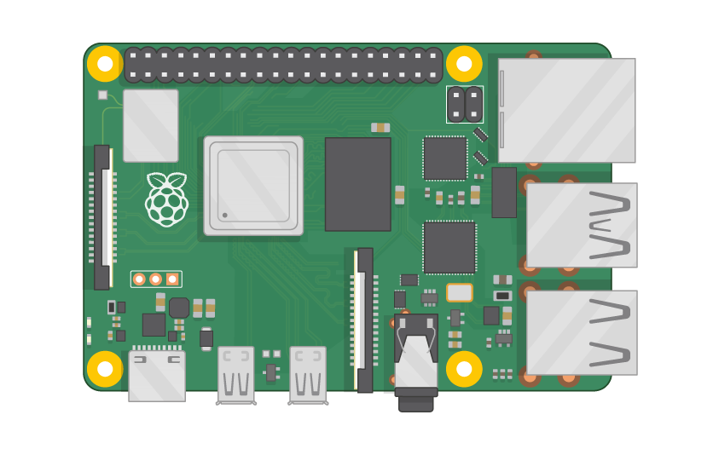
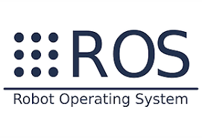
Methodology
Motor Left Front
Motor Left Rear
Motor Right Front
Motor Right Rear
Motor Driver Left
Motor Driver Right
Subscribe
Computer Vision Coordinates / Remote Controller
Camera + Sensor
Robot Controller Node
Publish
Speed / Angles
Algorithm
Robot Controlling with PID / Hazards Identification
Raspberry Pi
IT19973470 | Gunawardana I.I.E | TMP-23-044

Slide 22
Autonomous
Computer Vision Coordinates
TeaBot
Manual
Remote Controller
IT19973470 | Gunawardana I.I.E | TMP-23-044

Slide 23
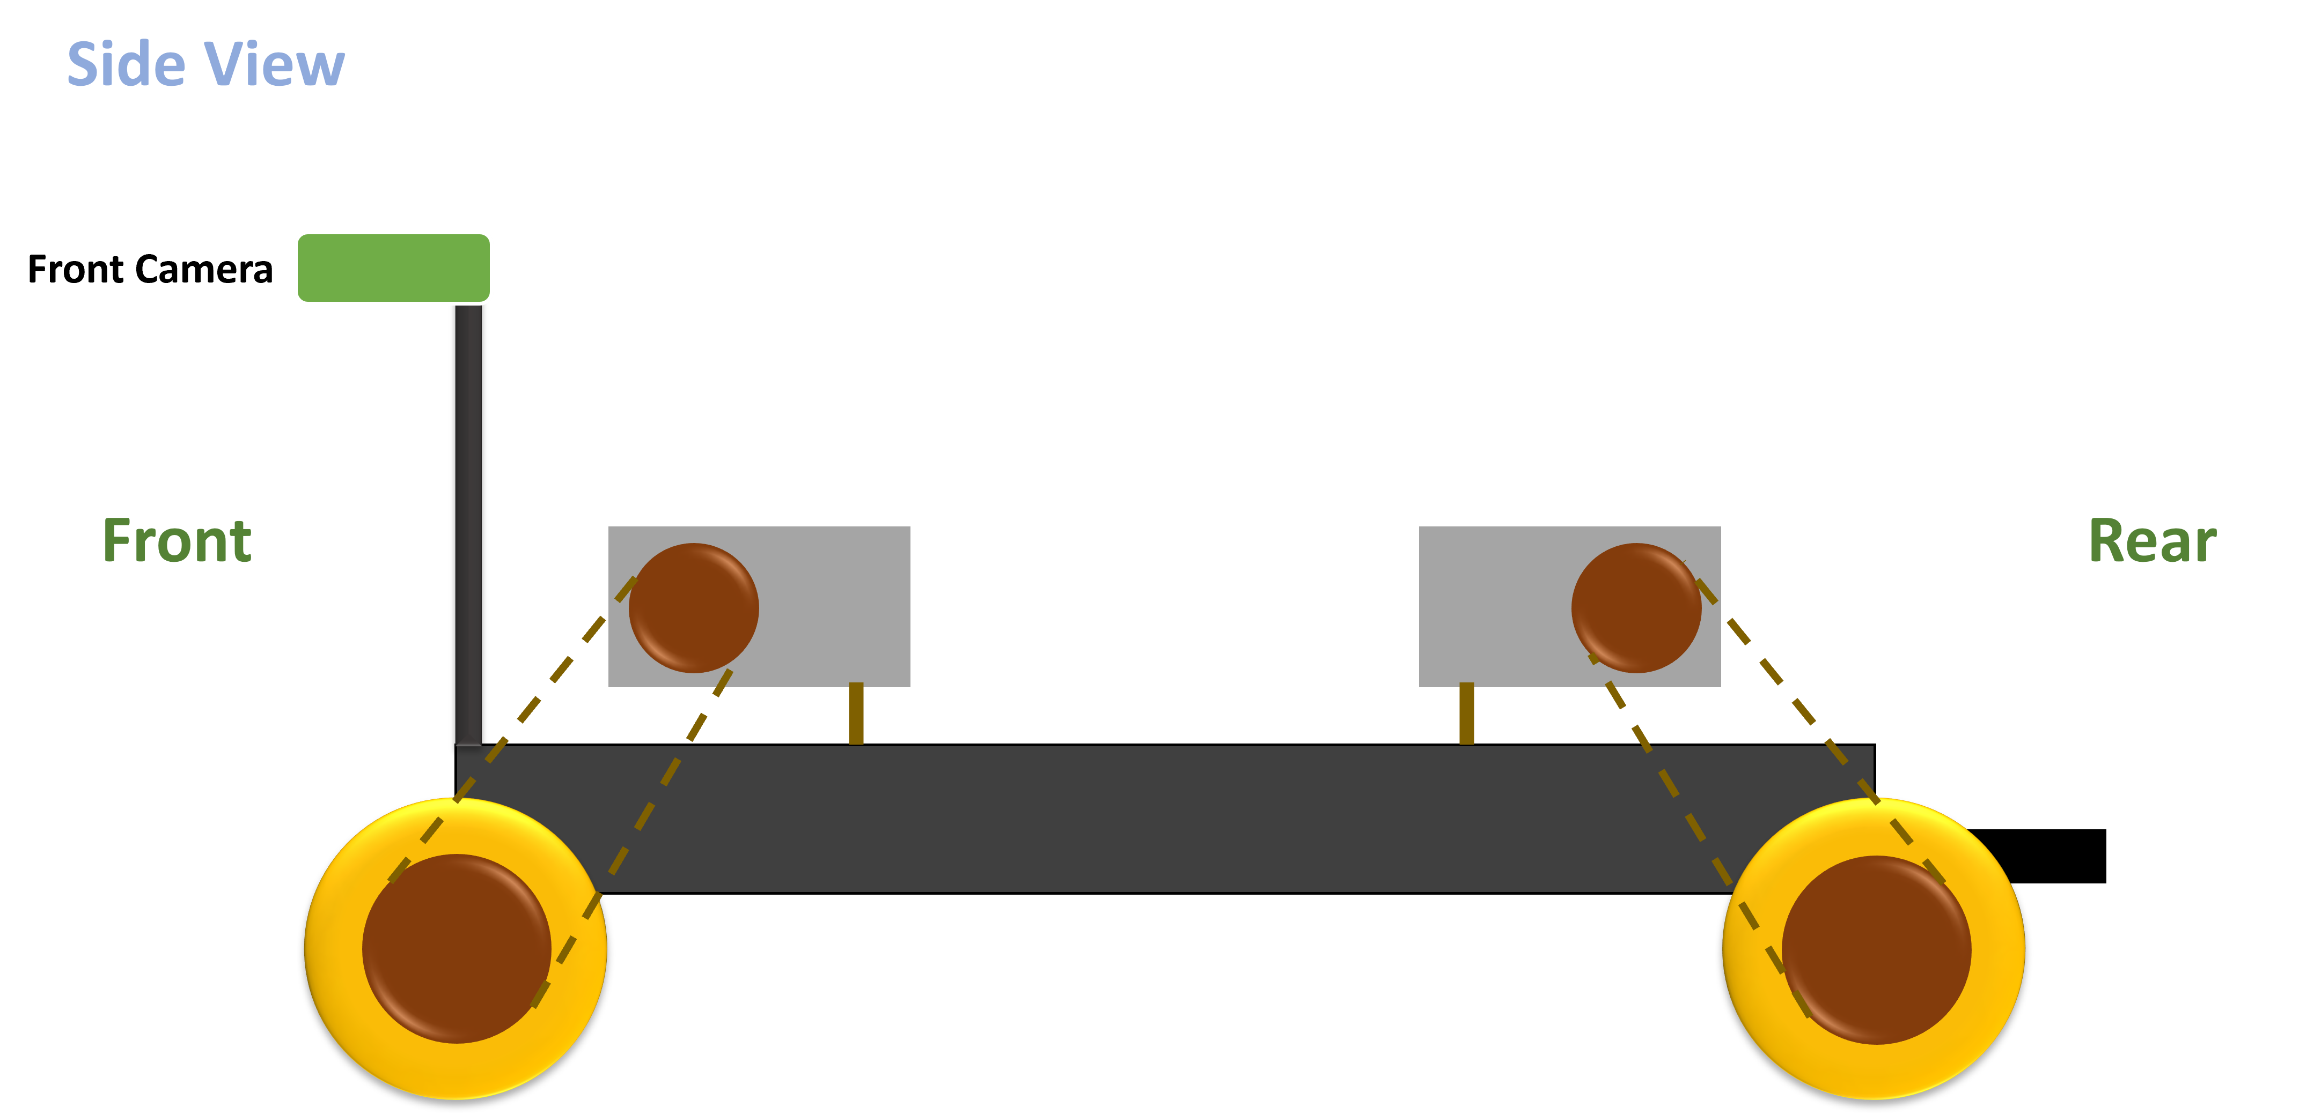
IT19973470 | Gunawardana I.I.E | TMP-23-044

Slide 24
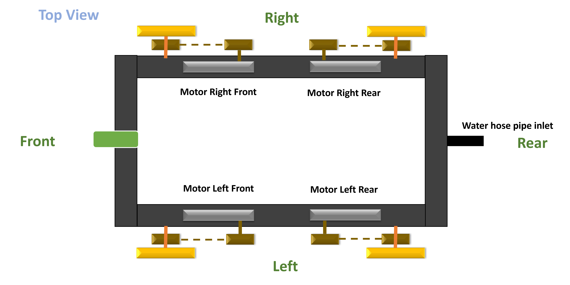
IT19973470 | Gunawardana I.I.E | TMP-23-044

Slide 25





Technologies
Technologies
Python
ROS
Algorithms
PID
Motor Control
Solid Works
React
Ubuntu
IT19973470 | Gunawardana I.I.E | TMP-23-044

Slide 26
Requirements
Functional Requirements
System Requirements
Four motors with sufficient power
Non-Functional Requirements
Accuracy
Personal Requirements
Farmers
Performance
Efficient
Easy to handle
Navigate the robot forward
Tea State owners
Sufficient processing power to drive and hazard identify
Driving the robot with the computer vision coordinates
Capability of hazards identification
Drive the robot in manual mode
Sufficient power supply
IT19973470 | Gunawardana I.I.E | TMP-23-044

Slide 27
Work Breakdown Structure
Robot Controller
Motor Controller
Autopilot
Remote Controller
Hazard Identification
Make the robot structure
Provide computer vision coordinates
React app for dashboard development
Make the hardware
Make the power supply
PID for steering
Create the communication
Use YOLO5 and Ultrasonic
Create the motor driving
PID controlling for speed
IT19973470 | Gunawardana I.I.E | TMP-23-044

Slide 28
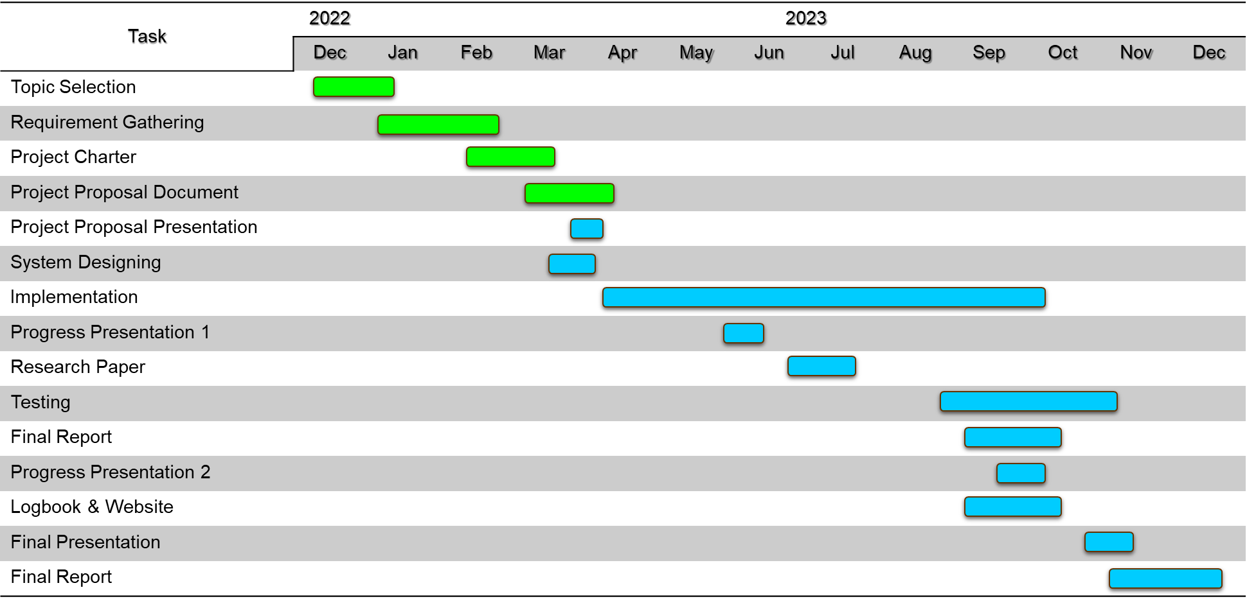
Gantt Chart
IT19973470 | Gunawardana I.I.E | TMP-23-044

Slide 29
References
[1] L. Grimstad and P. J. From, “Thorvald II - a Modular and Re-configurable Agricultural Robot,” IFAC-PapersOnLine, vol. 50, no. 1, pp. 4588–4593, 2017, doi: 10.1016/j.ifacol.2017.08.1005.
[2] Cihan YURTSEVER, Y. ERTAS, O. SUSTAM, and C. ULU, “Development of an Agriculture Robot for Row-type Seed Sowing Applications,” J. Selcuk. Spec. Issue 2020 (ICAT’20, vol. 2020, pp. 228–242, 2020.
[3] E. P. Godoy, G. T. Tangerino, R. A. Tabile, R. Y. Inamasu, and A. J. V. Porto, “Networked control system for the guidance of a four-wheel steering agricultural robotic platform,” J. Control Sci. Eng., vol. 2012, 2012, doi: 10.1155/2012/368503.
[4] P. Biber, U. Weiss, M. Dorna, and A. Albert, “Navigation System of the Autonomous Agricultural Robot ‘BoniRob,’” Work. Agric. Robot. Enabling Safe, Effic. Afford. Robot. Food Prod., pp. 1–7, 2012.
[5] T. Mueller-Sim, M. Jenkins, J. Abel, and G. Kantor, “The Robotanist: A ground-based agricultural robot for high-throughput crop phenotyping,” Proc. - IEEE Int. Conf. Robot. Autom., pp. 3634–3639, 2017, doi: 10.1109/ICRA.2017.7989418.
IT19973470 | Gunawardana I.I.E | TMP-23-044

Slide 30
IT20382476 Perera P.V.Y Data Science
IT20382476 | Perera P.V.Y | TMP-23-044

Slide 31
INTRODUCTION
IT20382476 | Perera P.V.Y | TMP-23-044

Slide 32
Background
Automatic navigation allows agriculture robots to navigate through the fields more efficiently, reducing the time and cost associated with manual navigation[1].
Automatic navigation requires accurate path detection and controlling the robot accordingly.
Path detection refers to identifying the route that the robot should follow to perform a particular task[2].
The relevant coordinates are then used to guide the robot along the path and ensure it stays on course.
TeaBot: Tea plantation preservation robot designed for automatic liquid fertilization. It will navigate through fields using computer vision path detection, identifying the route it needs to follow to deliver the liquid fertilizer to crops accurately.
The automatic path detection trend has shifted from classical methods to deep learning methods. Since it has been proven to be more accurate than previous traditional techniques[3].
IT20382476 | Perera P.V.Y | TMP-23-044

Slide 33
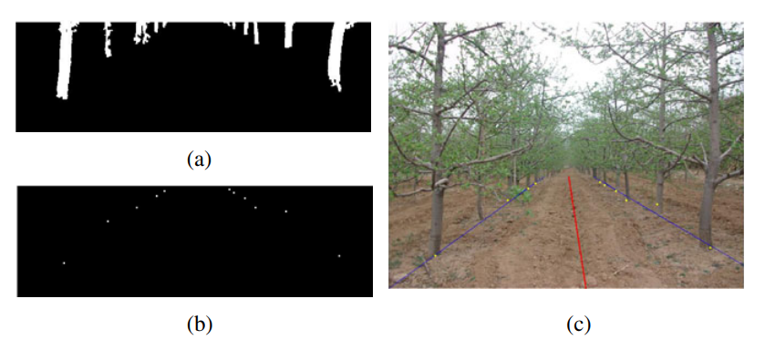
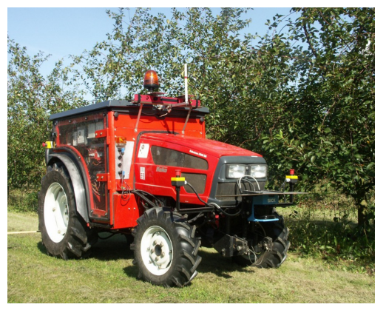
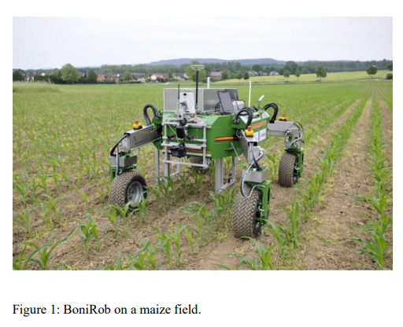
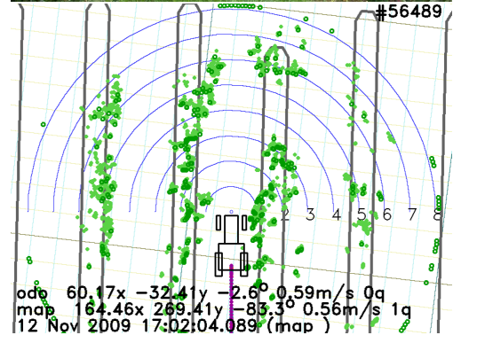
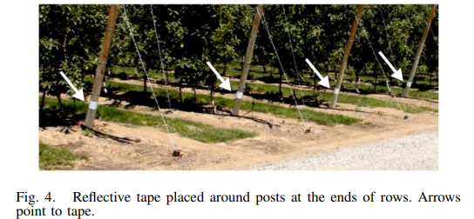
Implemented solutions
Path detection using machine learning methods [10]
GPS based navigation systems [6]
GPS & Laser [7] based method
Path detection using laser technology[8]
IT20382476 | Perera P.V.Y | TMP-23-044

Slide 34
Implemented solutions
GPS-based automatic navigation for remove infected potato plants[6]
For this robot, a GPS system is used. Obstacles such as tree canopy, can be a downside to automatic navigation[6].
Atmosphere conditions can slow down the navigation process and increase errors
GPS & Laser method to detect the tree rows[7]
This robot detects the tree rows with the help of laser technology.
Deployment of an automatic navigation system for an Outdoor Agriculture Vehicle[8]
Automatic navigation is developed using laser technology
Reflective tapes are used to detect the end of the path.
Auto Recognition of Navigation Path for Harvest Robot Based on Machine Vision[11]
Machine learning model has developed by scanning the tree trunks[10].
This algorithm is suitable for the orchard where the ground had less weed and the main area of standard trees were more visible
IT20382476 | Perera P.V.Y | TMP-23-044

Slide 35
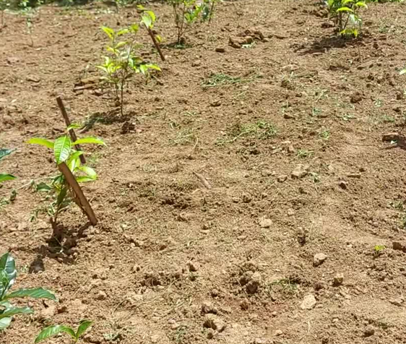
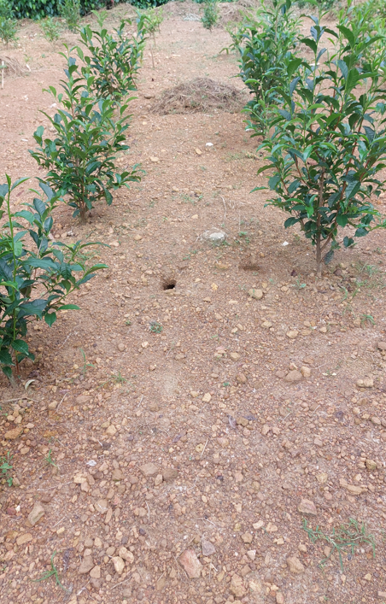
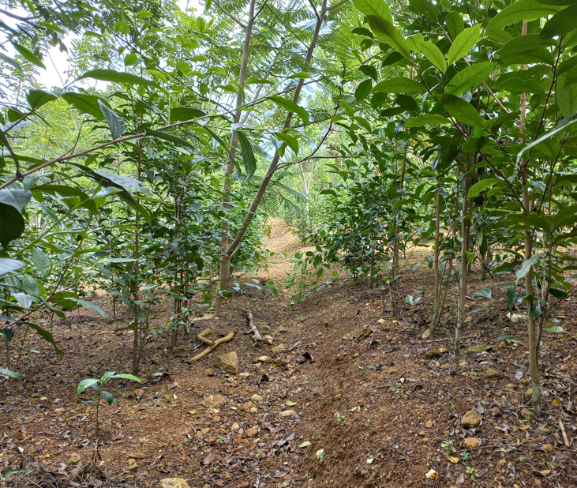
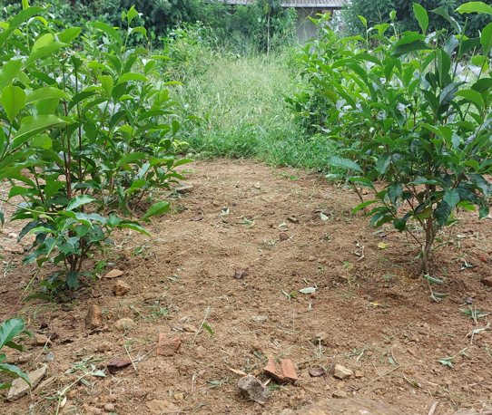
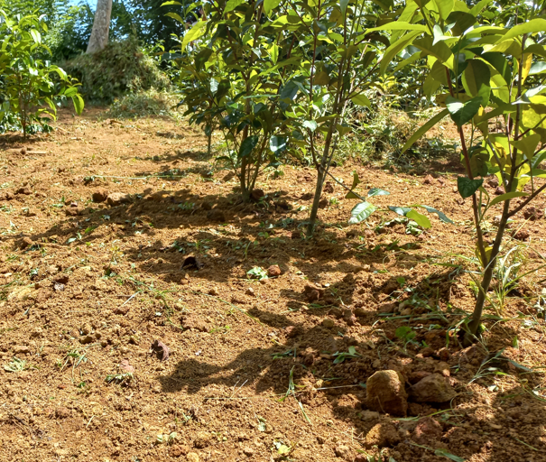
Varying environmental conditions
IT20382476 | Perera P.V.Y | TMP-23-044

Slide 36
Research Gap
Detecting the plantation rows in varying environmental conditions has not been addressed successfully[2],[4].
Determination of the end of the plantation rows has been a challenge[2],[5].
Poor performance in varying conditions of crop growth[11].
The inability of row center determination.
IT20382476 | Perera P.V.Y | TMP-23-044

Slide 37
Comparison
Main characteristics in automatic path detection | GPS based | Laser & GPS | Lidar based | Ultrasonic based | Machine learning | Image segmentation TeaBot
Performing in equal accuracy for varying conditions of crop growth | ✘ | ✘ | ✘ | ✘ | ✓ | ✓
Capability of row center determination | ✘ | ✘ | ✓ | ✘ | ✓ | ✓
Capability of detecting the plantation rows in varying field conditions (Adaptive Navigation) | ✘ | ✘ | ✘ | ✘ | ✘ | ✓
Identifying the end of the plantation rows | ✘ | ✓ | ✓ | ✘ | ✘ | ✓
IT20382476 | Perera P.V.Y| TMP-23-044

Slide 38
Research Question
How to create an algorithm to detect the tea plantation rows more accurately to help the robot navigate automatically?
IT20382476 | Perera P.V.Y | TMP-23-044

Slide 39
OBJECTIVES
IT20382476 | Perera P.V.Y | TMP-23-044

Slide 40
Specific Objective
The development of the image segmentation model to navigate the robot automatically in the tea plantation rows in varying environmental conditions
IT20382476 | Perera P.V.Y | TMP-23-044

Slide 41
Sub Objectives
Collecting the dataset, and applying data transforming, normalizing techniques.
Image segmentation model development, optimizing, and testing the model.
Communicating with the robot controller.
IT20382476 | Perera P.V.Y | TMP-23-044

Slide 42
METHODOLOGY
IT20382476 | Perera P.V.Y | TMP-23-044

Slide 43
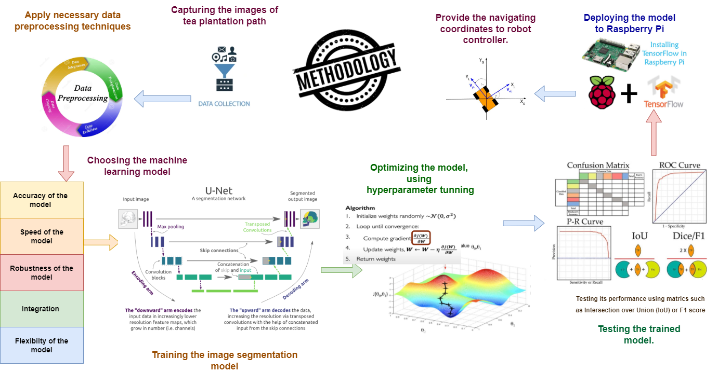
IT20382476 | Perera P.V.Y | TMP-23-044

Slide 44


Technologies
Technologies
Python
Algorithms
Machine Learning
Semantic Segmentation
TensorFlow
OpenCV
U-Net architecture
Computer Vision
ROS
IT20382476 | Perera P.V.Y | TMP-23-044

Slide 45
Requirements
Functional Requirements
System Requirements
ML model should be compatible with hardware & software
Non-Functional Requirements
User friendly
Personal Requirements
Farmers
Performance
Efficient and fast
Should be easily maintained
Accurately detect the path
Tea State owners
Adequate GPU processing power
Capability of handling various images
Capability of row center determination
Agriculture field experts
IT20382476 | Perera P.V.Y | TMP-23-044

Slide 46
Work Breakdown Structure
Tea Plantation Path Identification
Planning
Dataset Creation
Model Development
Testing & Validation
Data Transfer
Identifying the technologies
Identifying requirements
Identifying Algorithm & function
Allocating timeframe
Collecting the dataset
Data preprocessing
Using U-Net architecture
Evaluating the performance
Optimizing the model
Testing and verifying accuracy
Validating the output result
Integrating the ML model
Transferring the coordinators
Labeling
IT20382476 | Perera P.V.Y | TMP-23-044

Slide 47
Gannt Chart
IT20382476 | Perera P.V.Y | TMP-23-044

Slide 48
References
[1] S. Bonadies and S. A. Gadsden, “An overview of autonomous crop row navigation strategies for unmanned ground vehicles,” Eng. Agric. Environ. Food, vol. 12, no. 1, pp. 24–31, 2019, doi: 10.1016/j.eaef.2018.09.001.
[2] S. G. Vougioukas, “Agricultural Robotics,” Annu. Rev. Control. Robot. Auton. Syst., vol. 2, pp. 365–392, 2019, doi: 10.1146/annurev-control-053018-023617.
[3] I. Rakhmatuiln, A. Kamilaris, and C. Andreasen, “Deep neural networks to detectweeds from crops in agricultural environments in real-time: A review,” Remote Sens., vol. 13, no. 21, 2021, doi: 10.3390/rs13214486.
[4] H. Tian, T. Wang, Y. Liu, X. Qiao, and Y. Li, “Computer vision technology in agricultural automation —A review,” Inf. Process. Agric., vol. 7, no. 1, pp. 1–19, 2020, doi: 10.1016/j.inpa.2019.09.006.
[5] R. Carelli, “Agricultural Robotics,” no. September, pp. 48–58, 2013.
[6] R. Moeller, T. Deemyad, and A. Sebastian, “Autonomous Navigation of an Agricultural Robot Using RTK GPS and Pixhawk,” 2020 Intermt. Eng. Technol. Comput. IETC 2020, 2020, doi: 10.1109/IETC47856.2020.9249176.
[7] J. C. Andersen, O. Ravn, and N. A. Andersen, Autonomous rule-based robot navigation in orchards, vol. 7, no. PART 1. IFAC, 2010. doi: 10.3182/20100906-3-it-2019.00010.
[8] J. Libby and G. Kantor, “Deployment of a point and line feature localization system for an outdoor agriculture vehicle,” Proc. - IEEE Int. Conf. Robot. Autom., pp. 1565–1570, 2011, doi: 10.1109/ICRA.2011.5980430.
[9] P. Biber, U. Weiss, M. Dorna, and A. Albert, “Navigation System of the Autonomous Agricultural Robot ‘BoniRob,’” Work. Agric. Robot. Enabling Safe, Effic. Afford. Robot. Food Prod., pp. 1–7, 2012.
[10] J. VijiPriya, S. Suppiah, and R. Mohammad, “Wireless Ultrasonic Auto Navigation Robot for Agriculture,” Int. J. Comput. Eng. Res. Trends, vol. 6, no. 3, 2019, doi: 10.22362/ijcert/2019/v6/i03/v6i0301.
[11] B. He, G. Liu, Y. Ji, Y. Si, and R. Gao, “Auto recognition of navigation path for harvest robot based on machine vision,” IFIP Adv. Inf. Commun. Technol., vol. 344 AICT, no. PART 1, pp. 138–148, 2011, doi: 10.1007/978-3-642-18333-1_19.
[12] A. Stoll and H. D. Kutzbach, “Guidance of a forage harvester with GPS,” Precis. Agric., vol. 2, no. 3, pp. 281–291, 2000, doi: 10.1023/A:1011842907397.
IT20382476 | Perera P.V.Y | TMP-23-044

Slide 49
IT20265410 Premathilake H.T.M Information Technology
IT20265410 | Premathilake H.T.M | TMP-23-044

Slide 50
INTRODUCTION
IT20265410 | Premathilake H.T.M | TMP-23-044

Slide 51
Background
Stem identification refers, find the precise location of the tea plant which is exactly required for liquid feralization.
In Sri Lanka, there might be a water scarcity situation in the future [1].
To use resources sufficient way, identifying the precise location of the tea stem is important.
Most importantly, tea plant growth patterns and environmental factors needed to be considered.
Rather than traditional ways, machine learning could be leading to the most effective and efficient [2].
IT20265410 | Premathilake H.T.M | TMP-23-044

Slide 52
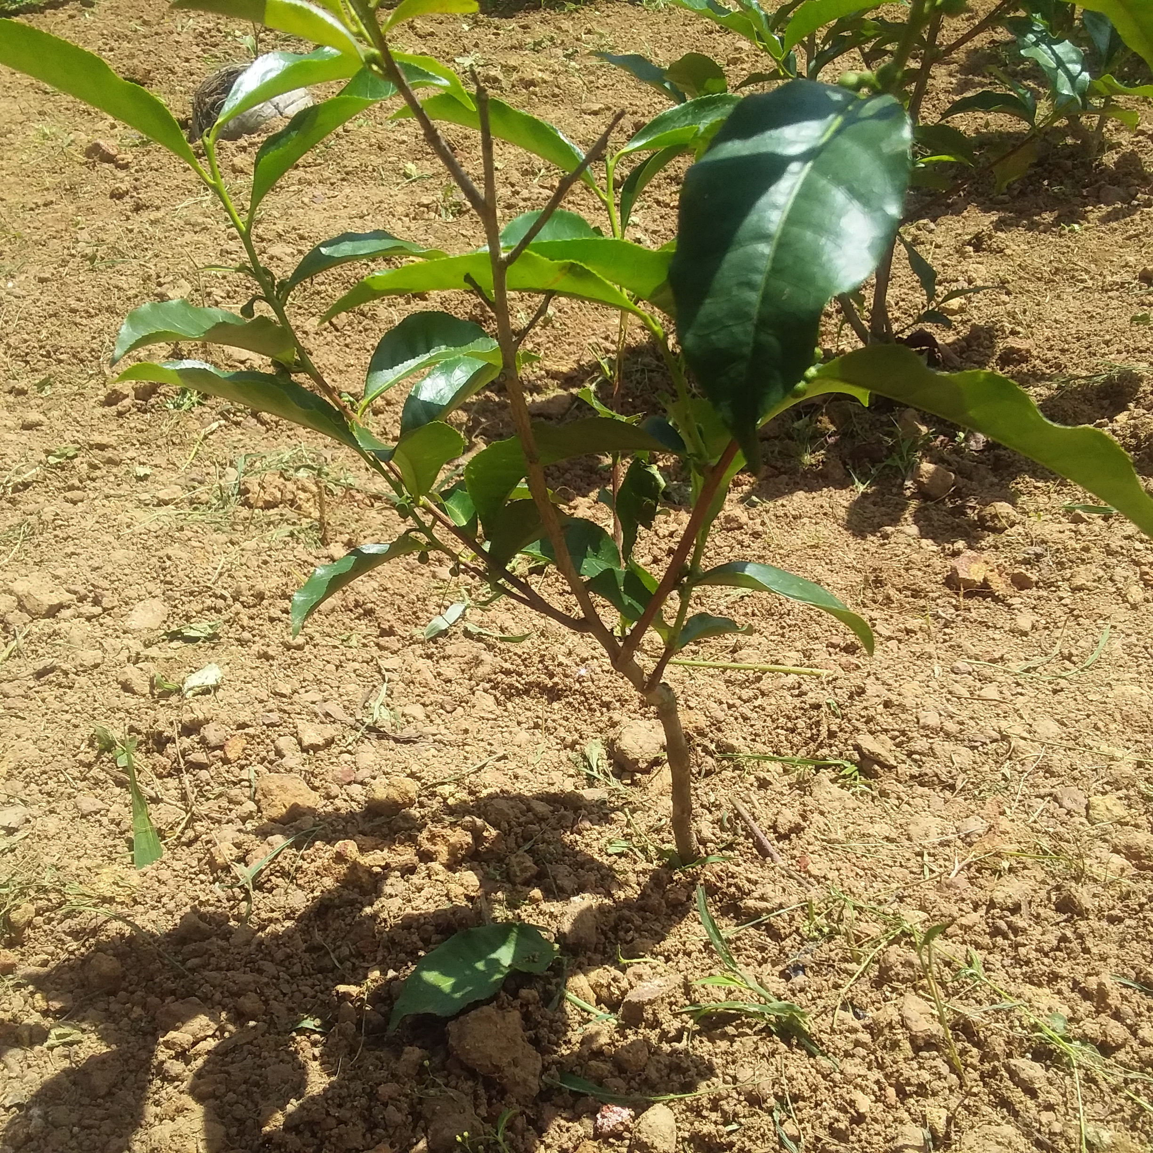
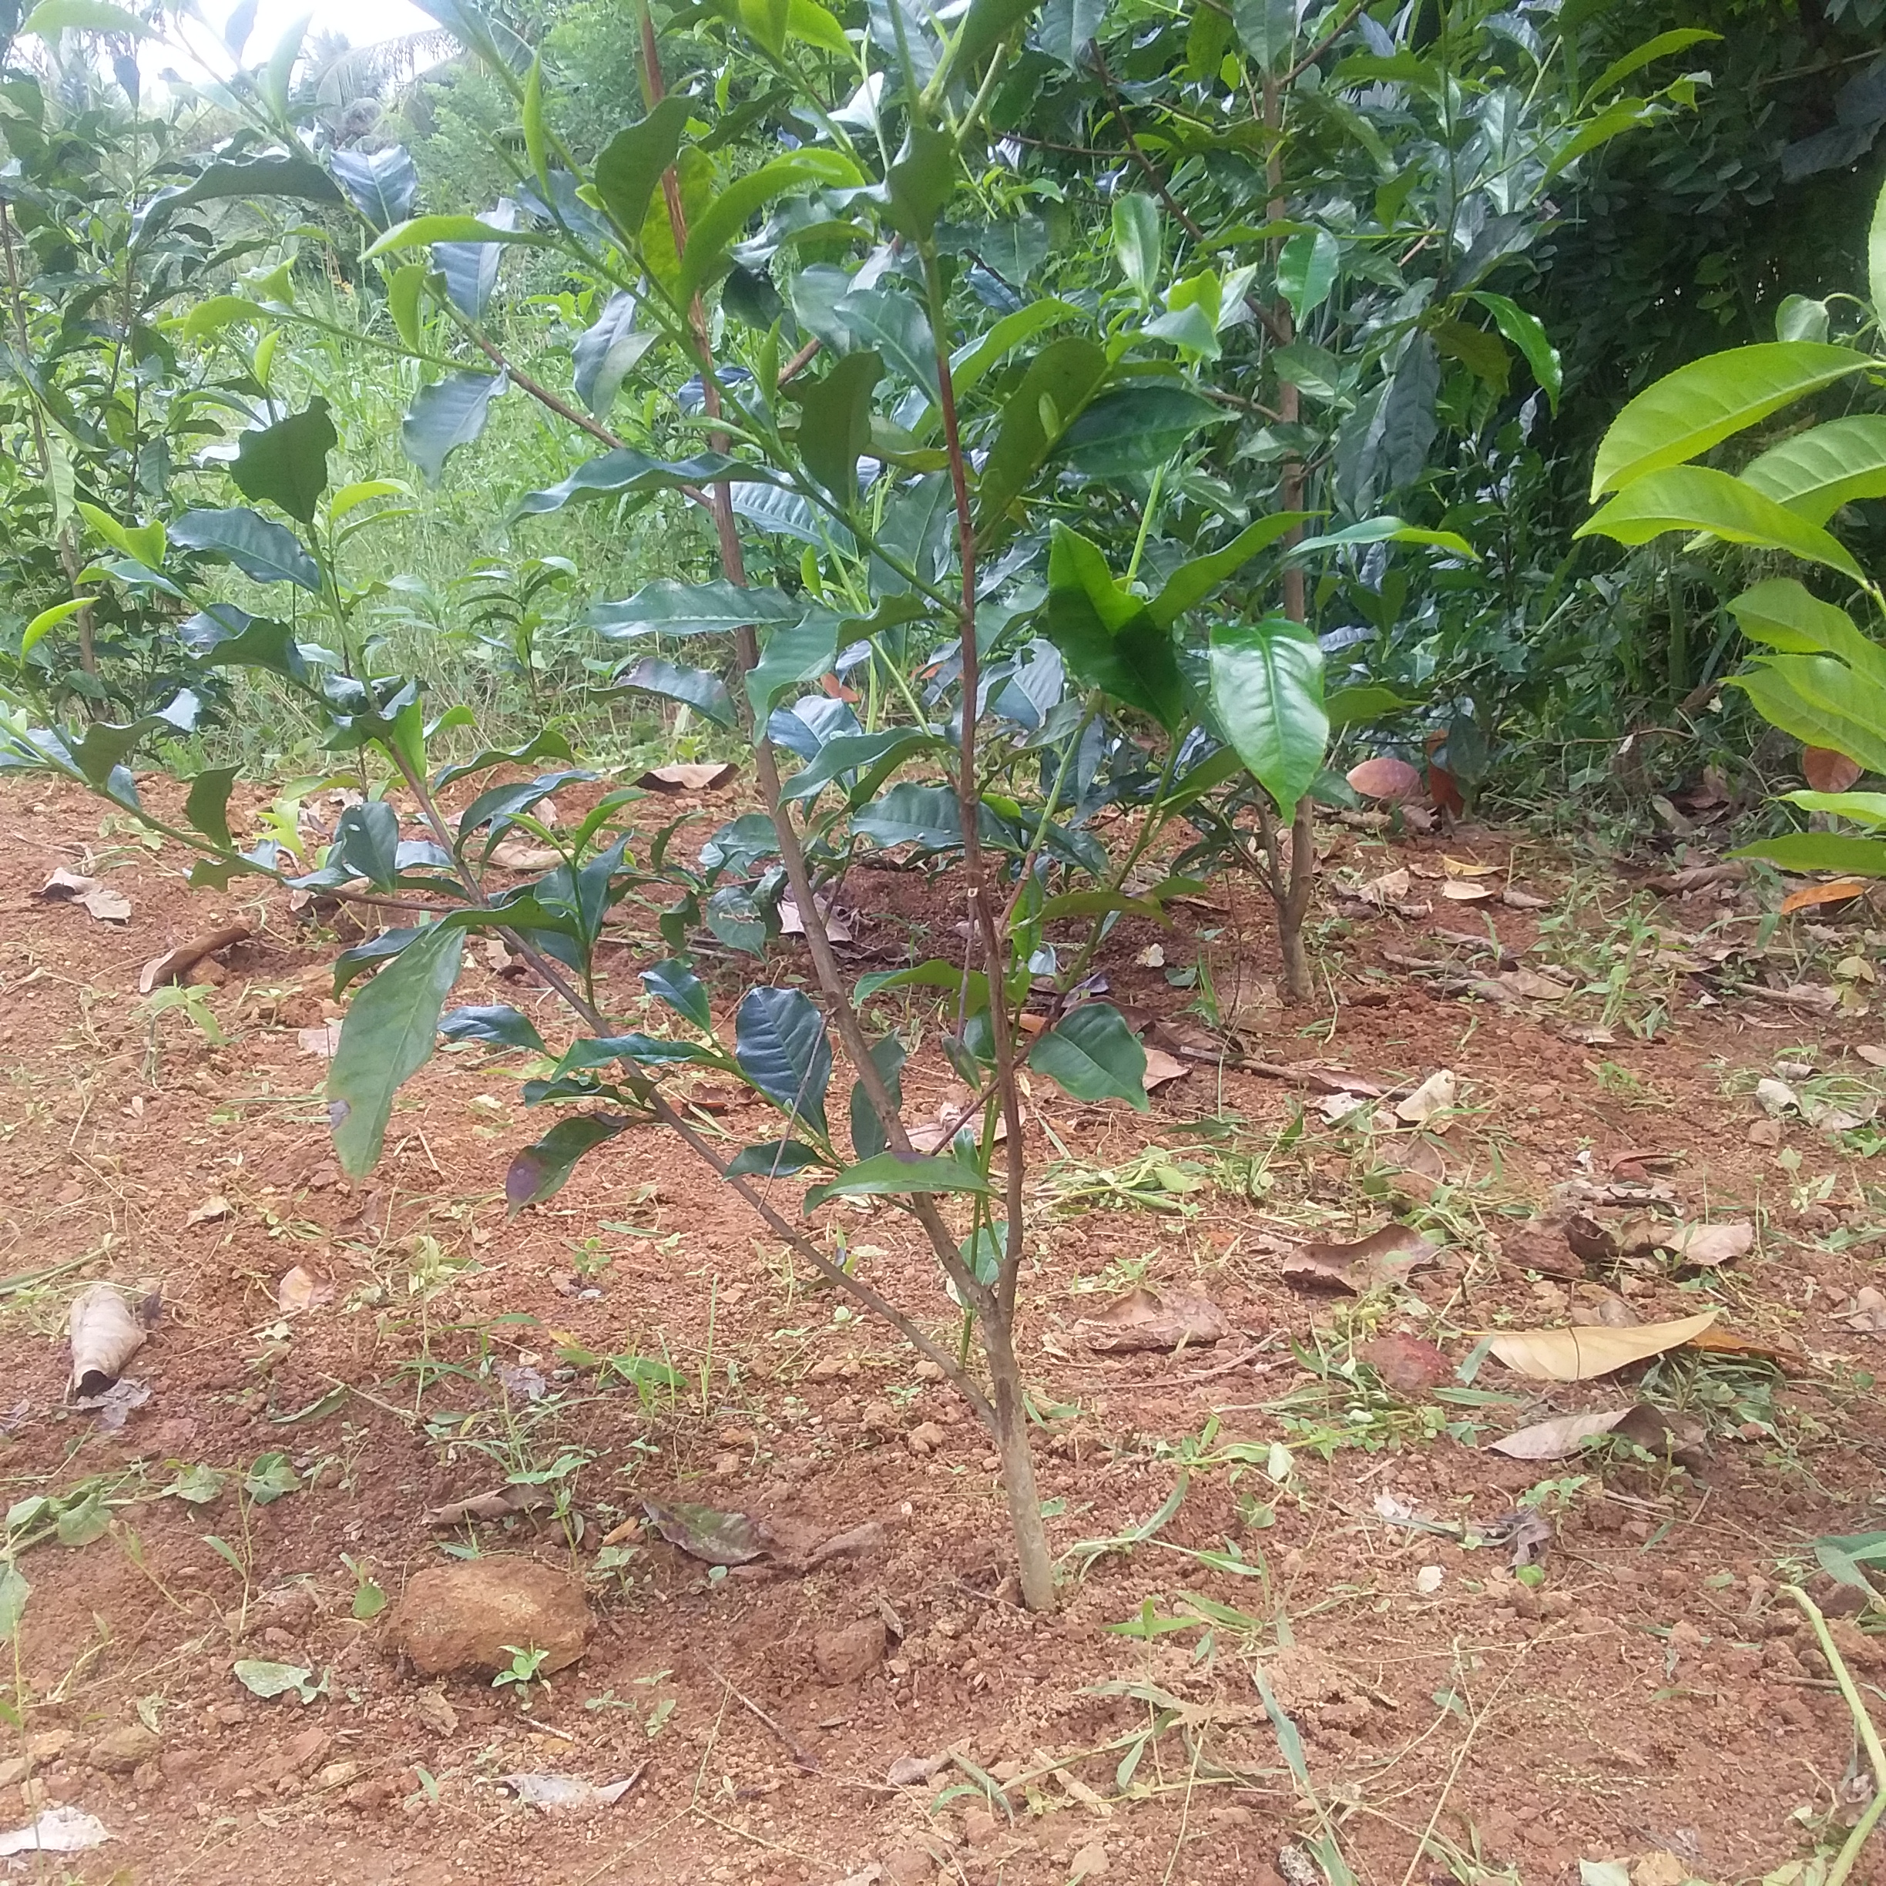
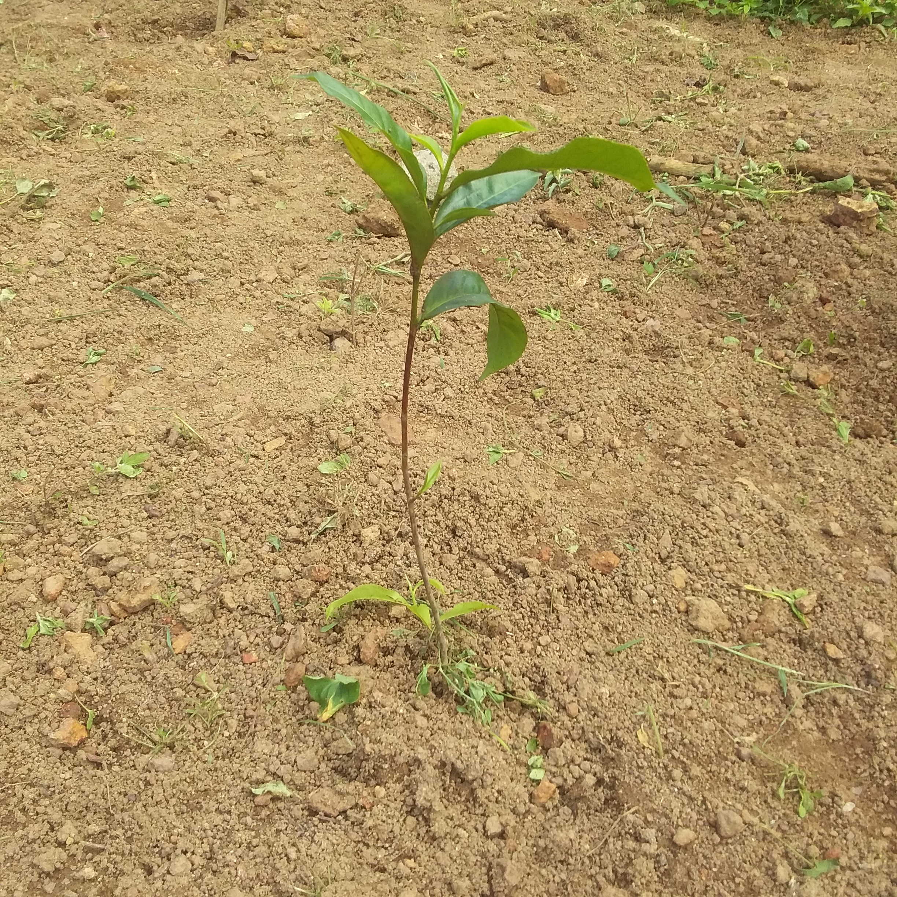
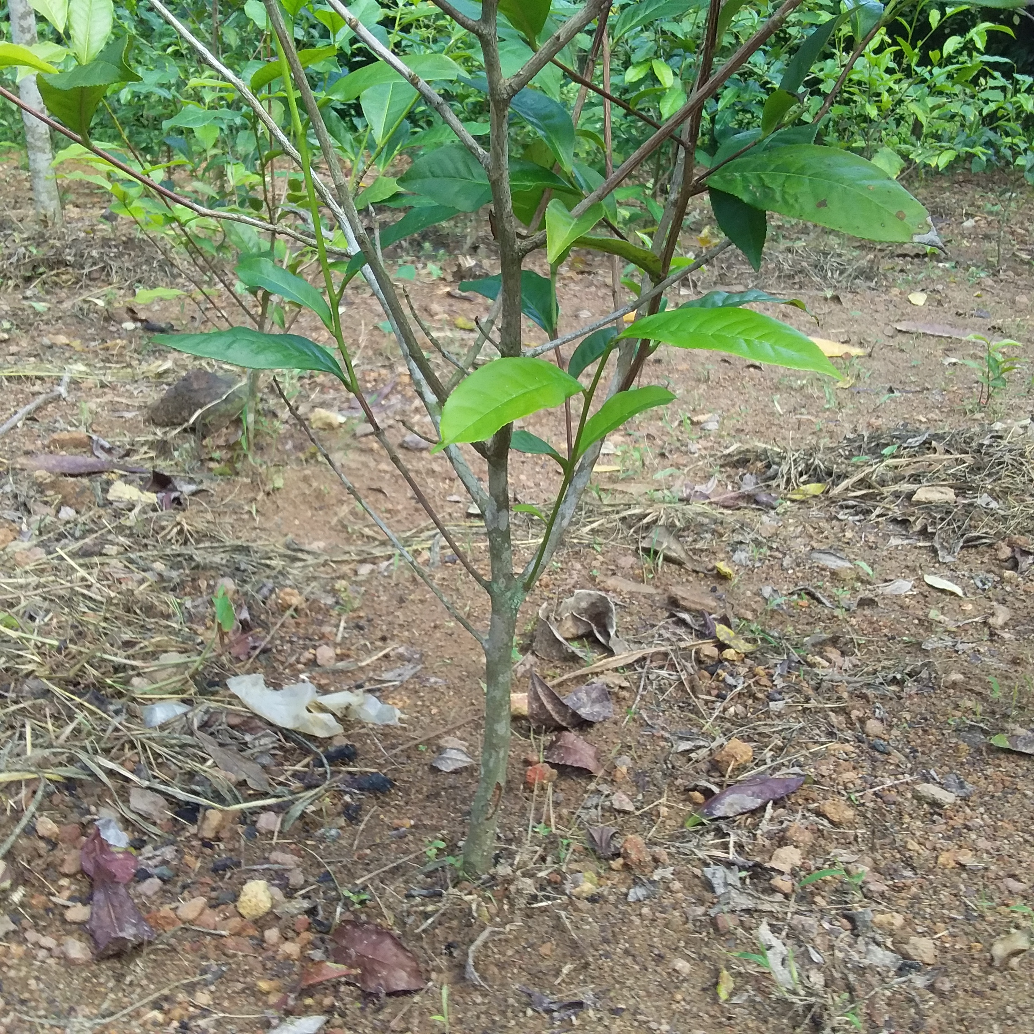
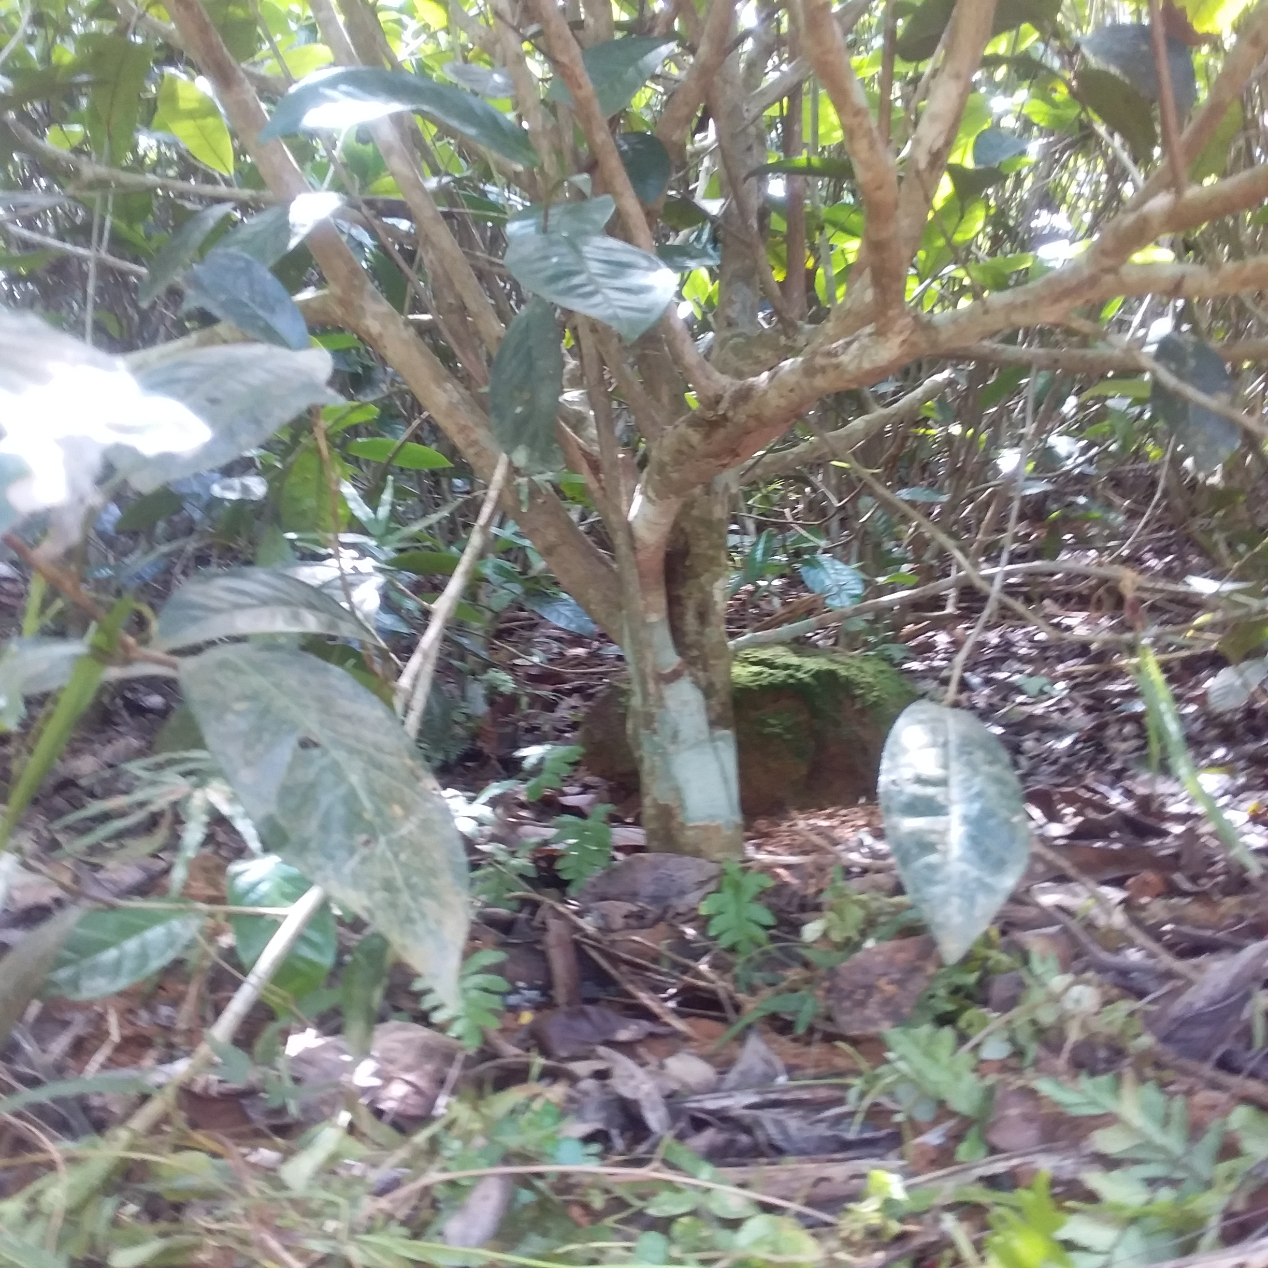
Different Lightening Conditions
Growing Pattern of Tea Stems
IT20265410 | Premathilake H.T.M | TMP-23-044

Slide 53
Implemented Solutions
Stem of Sweet-Pepper Localization [4]
Sugarcane Stem Detection [6]
X‐RAY Based Stem Detection [5]
IT20265410 | Premathilake H.T.M | TMP-23-044

Slide 54
Research Gap
Not exclusively focused on the tea plantation and preservation.
Studies have not been conducted to identify the end of the tea stem.
Not aligned with the liquid fertilizing process.
Identify the variability in tea stem growth patterns.
Use machine learning techniques, compared to other methodologies.
IT20265410 | Premathilake H.T.M | TMP-23-044

Slide 55
Comparison
Research | Methodologies that used to identify the stem | Identify the end of the stem | Pass coordinators as the output | Aligned with liquid fertilizing process | Agricultural robot | Purpose
Real-Time Computer Vision for Tree Stem Detection [19] | CNN based (Object Detection) | ✘ | ✓ | ✘ | ✘ | Forest operations’ sustainability
Stem localization of sweet pepper [21] | X‐ray based | ✘ | ✘ | ✘ | ✓ | Harvesting
Stem detection in an automatic tomato weeding system [22] | X‐ray based | ✘ | ✘ | ✘ | ✓ | Weeding system
Sugarcane pre-cut seed [23] | Object detection and image processing | ✘ | ✘ | ✘ | ✘ | Seed cutting
TeaBot | CNN based | ✓ | ✓ | ✓ | ✓ | Liquid fertilizing
IT20265410 | Premathilake H.T.M | TMP-23-044

Slide 56
Research Question
How to give the coordinates of the end of the tea stem in order to fulfill the liquid fertilizing process?
IT20265410 | Premathilake H.T.M | TMP-23-044

Slide 57
OBJECTIVES
IT20265410 | Premathilake H.T.M | TMP-23-044

Slide 58
Specific Objective
Develop an image processing algorithm to precisely identify the end of the stem and pass the coordinators to the liquid spraying controller.
IT20265410 | Premathilake H.T.M | TMP-23-044

Slide 59
Sub Objectives
Gathered dataset and apply preprocessing techniques
Developing, testing and optimizing the image processing model
Transfer data to liquid spraying controller
IT20265410 | Premathilake H.T.M | TMP-23-044

Slide 60
METHODOLOGY
IT20265410 | Premathilake H.T.M | TMP-23-044

Slide 61
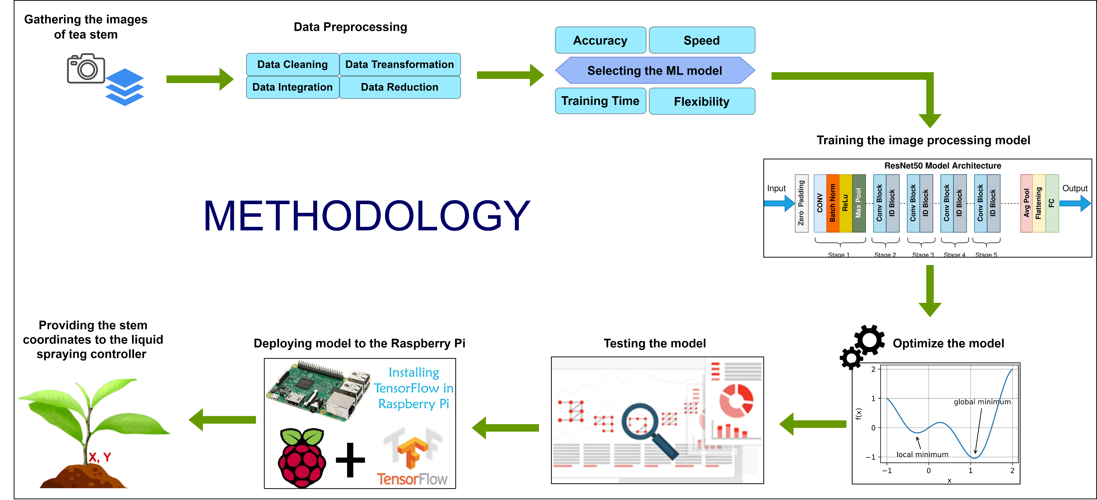
IT20265410 | Premathilake H.T.M | TMP-23-044

Slide 62
Technologies
Technologies
Python
Algorithms
Machine Learning
Image Processing
TensorFlow
OpenCV
ResNet Architecture
Computer Vision
ROS
IT20265410 | Premathilake H.T.M | TMP-23-044

Slide 63
Requirements
Functional Requirements
System Requirements
ML model must align with hardware and software
Non-Functional Requirements
User friendly
Personal Requirements
Famers
Capability to get the correct coordinates
Precisely identify the end of the tea stem
Tea State owners
Agriculture field experts
Sufficient memory and processing power
Adequate GPU (Graphics Processing Unit) strength
Capability to pass the accurate coordinates to the liquid spraying controller
Performance
Efficient
Should be easily maintained
IT20265410 | Premathilake H.T.M | TMP-23-044

Slide 64
Work Breakdown Structure
Tea Stem Identification
Planning
Dataset Creation
Model Development
Testing & Validation
Data Transfer
Identifying requirements
Collecting the dataset
Using ResNet architecture
Testing and verifying accuracy
Integrating the ML model
Identifying Algorithm & function
Data preprocessing
Evaluating the performance
Validating the output result
Transferring the coordinators
Identifying the technologies
Labeling
Optimizing the model
Allocating timeframe
IT20265410 | Premathilake H.T.M | TMP-23-044

Slide 65
Gantt Chart
IT20265410 | Premathilake H.T.M | TMP-23-044

Slide 66
References
[1] “Ministry of Defence - Sri Lanka.” https://www.defence.lk/Article/view_article/4922 (accessed Mar. 26, 2023).
[2] “Machine Learning in Agriculture: 5 Priceless Benefits.” https://www.farmerp.com/machine-learning-in-agriculture-identifying-patterns-to-improve-crop-performances (accessed Mar. 26, 2023).
[3] L. A. Wells and W. Chung, “Real-Time Computer Vision for Tree Stem Detection and Tracking,” For. 2023, Vol. 14, Page 267, vol. 14, no. 2, p. 267, Jan. 2023, doi: 10.3390/F14020267.
[4] C. W. Bac, J. Hemming, and E. J. Van Henten, “Stem localization of sweet-pepper plants using the support wire as a visual cue,” Comput. Electron. Agric., vol. 105, pp. 111–120, Jul. 2014, doi: 10.1016/J.COMPAG.2014.04.011.
[5] R. P. Haff, D. C. Slaughter, and E. S. Jackson, “X-Ray Based Stem Detection in an Automatic Tomato Weeding System,” Appl. Eng. Agric., vol. 27, no. 5, pp. 803–810, 2011, doi: 10.13031/2013.39559.
[6] W. Wang, C. Li, K. Wang, L. Tang, P. F. Ndiluau, and Y. Cao, “Sugarcane stem node detection and localization for cutting using deep learning,” Front. Plant Sci., vol. 13, p. 5181, Dec. 2022, doi: 10.3389/FPLS.2022.1089961/BIBTEX.
IT20265410 | Premathilake H.T.M | TMP-23-044

Slide 67
IT20011970 Bamunusinghe G.P Software Engineering
IT20011970 | Bamunusinghe G.P | TMP-23-044

Slide 68
INTRODUCTION
IT20011970 | Bamunusinghe G.P | TMP-23-044

Slide 69
Background
The movement of the robot arm and the liquid nozzles must be precisely controlled to ensure the accuracy and efficiency of the application.
The velocity of the robot affects the movement of the robotic arm’s movement of the liquid nozzles, and this must be taken into account in the control system.
PID control is a widely used method for fine-tuning the movement of robotic arms[5], including the movement of liquid nozzles in liquid sprayer systems.
Regulating water pressure is also important to ensure consistent application, and detecting and responding to water blockages can prevent damage to crops and the environment.
IT20011970 | Bamunusinghe G.P | TMP-23-044

Slide 70
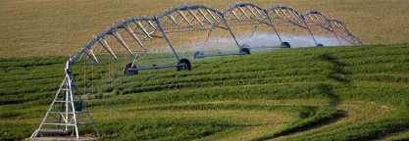
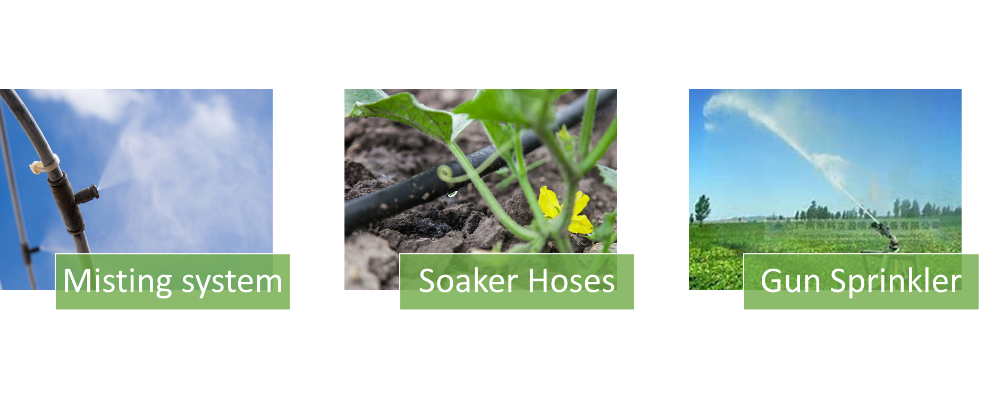
Implemented Solutions
[1]
[7]
[7]
[7]
IT20011970 | Bamunusinghe G.P | TMP-23-044

Slide 71
Research Gap
Most of spraying systems waste lots of water and efficiency is low[9]
There is no specific system to detect root and water them accurately
There is no specific system to validate water spraying path
For tea plants, misting fertilizer is not recommended.
Most of the systems do not have stabilizing water spraying nozzles
IT20011970 | Bamunusinghe G.P | TMP-23-044

Slide 72
Comparison
Irrigation System | Eligibility for tea field liquid fertilization | Watering scale | Issues | Mechanism
Pressurized irrigation systems include sprinkler[2][3] | ✘ | Long | High cost | These systems spray pressurized water across the system and distribute water via pipelines.[2]
Solid set sprinkler systems[4][3] | ✘ | Long | Incorrect operating pressure reduce efficiency[2] | Sprinklers are permanently fixed in well-designed solid set systems at spacings that produce the best consistency.[2]
Gun sprinkler systems[2][3] | ✘ | Very long | wind drift and evaporation losses lots of water[2] | Large sprinklers known as "gun sprinklers" release water at high pressures and flow rates. [2]
Center pivot and lateral move systems[2][4] | ✘ | Medium | losses lots of water from the guns[2] | lateral move systems that increase the irrigated area by adding gun sprinklers to the extremities of the laterals [2]
Drip and line source systems[2][6] | ✓ | Short | High maintenance and management cost | Apply water in tiny drops or streams from individual drip emitters to the soil's surface or just below it. [2]
Subirrigation systems[2] | ✓ | Short | Large installing cost and maintaining | A new water table is created over an existing one or one that is constrained by a layer of dirt. [2]
TeaBot water spraying system | ✓ | Short | Solve lots of above- mentioned problems | water is fired from a sprinklers establish in robot
IT20011970 | Bamunusinghe G.P | TMP-23-044

Slide 73
Research Question
How to water the plants precisely according to the coordinates with the relative velocity of the robot ?
IT20011970 | Bamunusinghe G.P | TMP-23-044

Slide 74
OBJECTIVES
IT20011970 | Bamunusinghe G.P | TMP-23-044

Slide 75
Specific Objective
To Develop the liquid nozzles controller of the TeaBot to liquid fertilize the tea plants more efficiently.
IT20011970 | Bamunusinghe G.P | TMP-23-044

Slide 76
Sub Objectives
Develop the motor controlling for the nozzles with PID controls.
Move the liquid nozzles to the exact spot with the given coordinates by the controller.
Develop the nozzle movements with the given coordinates by computer vision.
To move the nozzles with the relative velocity of the robot.
To regulate water pressure and, if water blocks occur, have the system turn itself off
IT20011970 | Bamunusinghe G.P | TMP-23-044

Slide 77
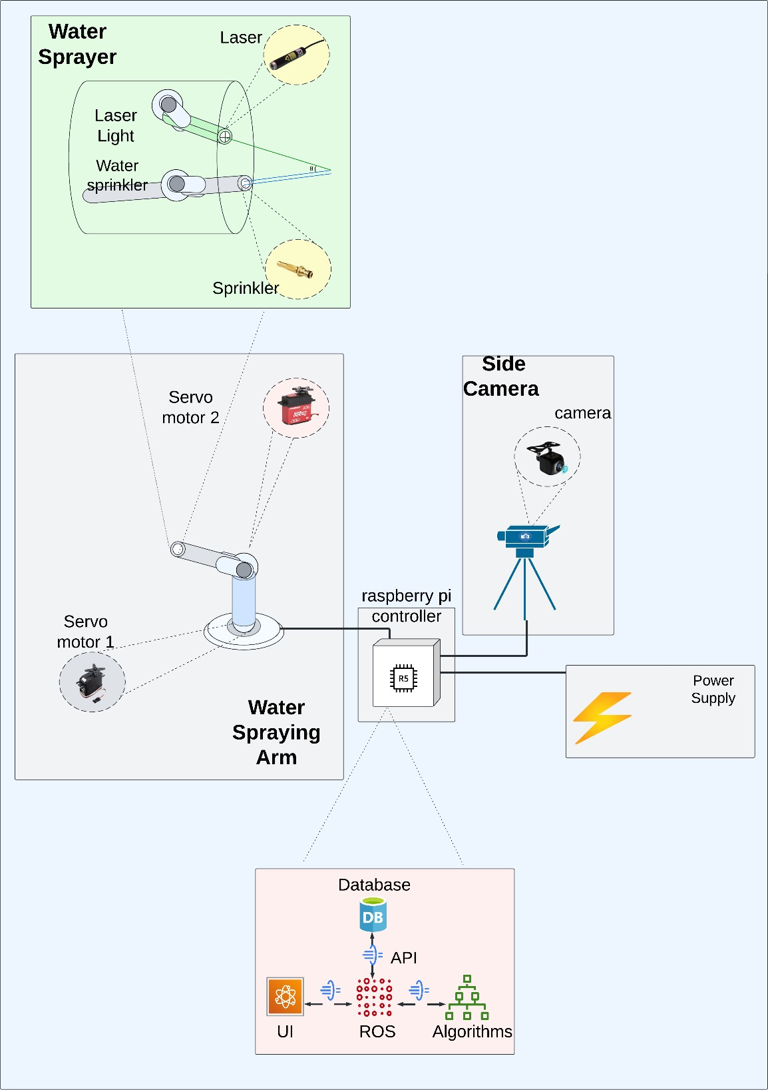
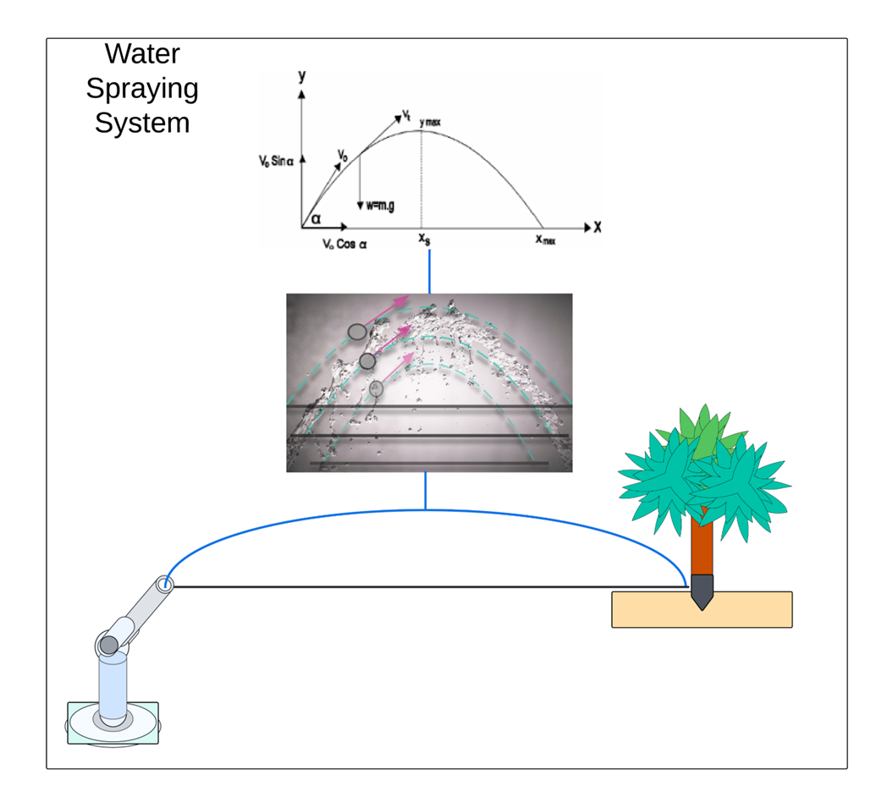
Methodology
IT20011970 | Bamunusinghe G.P | TMP-23-044

Slide 78


Technologies
Technologies
Python
ROS
Algorithms
PID
Servo Motor Control
Solid Works
Raspberry Pi
Ubuntu
IT20011970 | Bamunusinghe G.P | TMP-23-044

Slide 79
Requirements
Functional Requirements
System Requirements
Computational power to run the algorithm
Non-Functional Requirements
Accuracy
Personal Requirements
Farmers
Performance
Speed
Water spraying to the stem.
Tea State owners
Rotation angles of the motor
Rotation of the water arm.
Agriculture field experts
Water spraying angle control.
Water pressure control
Reusability
Continuous water flow
IT20011970 | Bamunusinghe G.P | TMP-23-044

Slide 80
Work Breakdown Structure
Liquid Sprayer
Arm & Hardware
Algorithm & Software
Laser Tracker
Mechanical design
Ideation
Mechanical design
3D printing
Coding
Hardware development
Firmware
Testing
Assembling
Assembling
IT20011970 | Bamunusinghe G.P | TMP-23-044

Slide 81
Gannt Chart
IT20011970 | Bamunusinghe G.P | TMP-23-044

Slide 82
References
[1]A. Shilpa, V. Muneeswaran, and D. Devi Kala Rathinam, “A Precise and Autonomous Irrigation System for Agriculture: IoT Based Self Propelled Center Pivot Irrigation System,” 2019 5th Int. Conf. Adv. Comput. Commun. Syst. ICACCS 2019, pp. 533–538, Mar. 2019, doi: 10.1109/ICACCS.2019.8728550.
[2] a G. Smajstrla et al., “Efficiencies of Florida Agricultural Irrigation Systems,” BUL247, Univ. Florida, no. July 2002, p. 14, 2002.
[3] A. Heideker, D. Ottolini, I. Zyrianoff, A. T. Neto, T. Salmon Cinotti, and C. Kamienski, “IoTbased Measurement for Smart Agriculture,” 2020 IEEE Int. Work. Metrol. Agric. For. MetroAgriFor 2020 - Proc., pp. 68–72, 2020, doi: 10.1109/MetroAgriFor50201.2020.9277546.
[4] D. Cooley, R. M. Maxwell, and S. M. Smith, “Center Pivot Irrigation Systems and Where to Find Them: A Deep Learning Approach to Provide Inputs to Hydrologic and Economic Models,” Front. Water, vol. 3, Dec. 2021, doi: 10.3389/frwa.2021.786016.
[5] C. Cruz Ulloa, A. Krus, A. Barrientos, J. del Cerro, and C. Valero, “Robotic Fertilization in Strip Cropping using a CNN Vegetables Detection-Characterization Method,” Comput. Electron. Agric., vol. 193, no. January, p. 106684, 2022, doi: 10.1016/j.compag.2022.106684.
[6]“Greenhouse Irrigation - What’s the best watering system? | Greenhouse Emporium.” https://greenhouseemporium.com/blogs/greenhouse-gardening/greenhouse-irrigationsystems/ (accessed Mar. 20, 2023).
IT20011970 | Bamunusinghe G.P | TMP-23-044

Slide 83
Budget
Item | Quantity | Amount (LKR)
Rubber wheels | 4 | 4,000
Sprocket, chain and wheel (gear system) | 4 | 10,800
Iron frame | 1 | 15,500
Motors | 4 | 14,000
43A Motor drivers | 4 | 5,400
Raspberry Pi zero w | 1 | 5,600
12V 45A battery | 1 | 30,000
Camera | 3 | 15,000
Liquid nozzles | 2 | 3,000
Servo motors | 8 | 9,600
Total |  | 112,900

Slide 84

Commercialization
Niche Marketing – (Tea Planters).
Brand Awareness – (Facebook, Instagram, Website).
TeaBot Subscription.
1-year Hardware Warranty
Software updates for 4 years.

Slide 85
THANK YOU!

Slide 86
Q & A

